Slide 1
Supply Chain Drivers and Metrics

Slide 2
Learning Objectives
Describe key financial measures of firm performance.
Identify the major drivers of supply chain performance.
Discuss the role of each driver in creating strategic fit between the supply chain strategy and the competitive strategy.
Define the key metrics that track the performance of the supply chain in terms of each driver.
Describe the major obstacles that must be overcome to manage a supply chain successfully.

Slide 3
Financial Measures Of Performance
From a shareholder perspective, return on equity (ROE) is the main summary measure of a firm’s performance.
ROE = Net income
Average shareholder equity

Slide 4
Return on assets (ROA) measures the return earned on each dollar invested by the firm in assets.

Slide 5
Financial Data for Amazon
Table 3.1

Slide 6
Financial Measures Of Performance
An important ratio that defines financial leverage is accounts payable turnover (APT)

Slide 7
ROA can be written as the product of two ratios-profit margin and asset turnover

Slide 8
Financial Measures of Performance
Cash-to-cash (C2C) cycle roughly measures the average amount time from when cash enters the process as cost to when it returns as collected revenue.
C2C = days in inventory (1/INVT) + days receivable (1/ART)
– days payable (1/APT)

Slide 9
Drivers of Supply Chain Performance
To understand how a company can improve supply chain performance in terms of responsiveness and efficiency.
The logistical drivers-facilities, inventory , transport
The cross-functional drivers-information, sourcing, pricing

Slide 10
Drivers of Supply Chain Performance
1. Facilities
The actual physical locations in the supply chain network where the product is stored, assembled, or fabricated.
Production sites and storage sites
Example: An auto-parts distributor striving for responsiveness could have many warehousing facilities located close to customers even though this practice reduces efficiency.

Slide 11
Drivers of Supply Chain Performance
2.Inventory
Encompasses all raw materials, work in process, and finished goods.
Changing inventory policies affects supply chain.
Example: A clothing retailer can make itself more responsive by stocking large amounts of inventory and satisfying customer demand from stock,but it makes it less efficient.

Slide 12
Drivers of Supply Chain Performance
3.Transportation
Moving inventory from point to point.
It can take the form of many combinations of modes and routes.
Example: A mail-order catalogue company can use a faster mode of transportation such as FedEx to ship products, making it responsive but less efficient.

Slide 13
Drivers of Supply Chain Performance
4.Information
The biggest drivers consisting data of facilities, inventory, transportation, costs, prices etc.
Example:With information on customer demand patterns, a pharmaceutical company can produce and stock drugs in anticipation of customer demand, which makes the supply chain very responsive because customers will find the drugs they need when they need them. It also makes the chain efficient by providing bases for forecasting.

Slide 14
Drivers of Supply Chain Performance
5.Sourcing
The choice of who will perform a particular supply chain activity such as production, storage, transportation. It determines what functions a firm performs and what functions the firm outsources.
Example: Motorola outsourced much of its production to contract manufacturers in China, improved efficiency, but its responsiveness suffer because of the long distances.

Slide 15
Drivers of Supply Chain Performance
Example:Flextronics, an electronics contract manufacturer, is trying to make its production facilities in the United States very responsive while keeping its facilities in low-cost countries efficient.

Slide 16
Drivers of Supply Chain Performance
6.Pricing
It determines how much a firm will charge for goods and services.
Example: If a transportation company varies its charges based on the lead time provided by the customers, it is very likely that customers who value efficiency will order early and customers who value responsiveness will order just before they need a product transported.

Slide 17
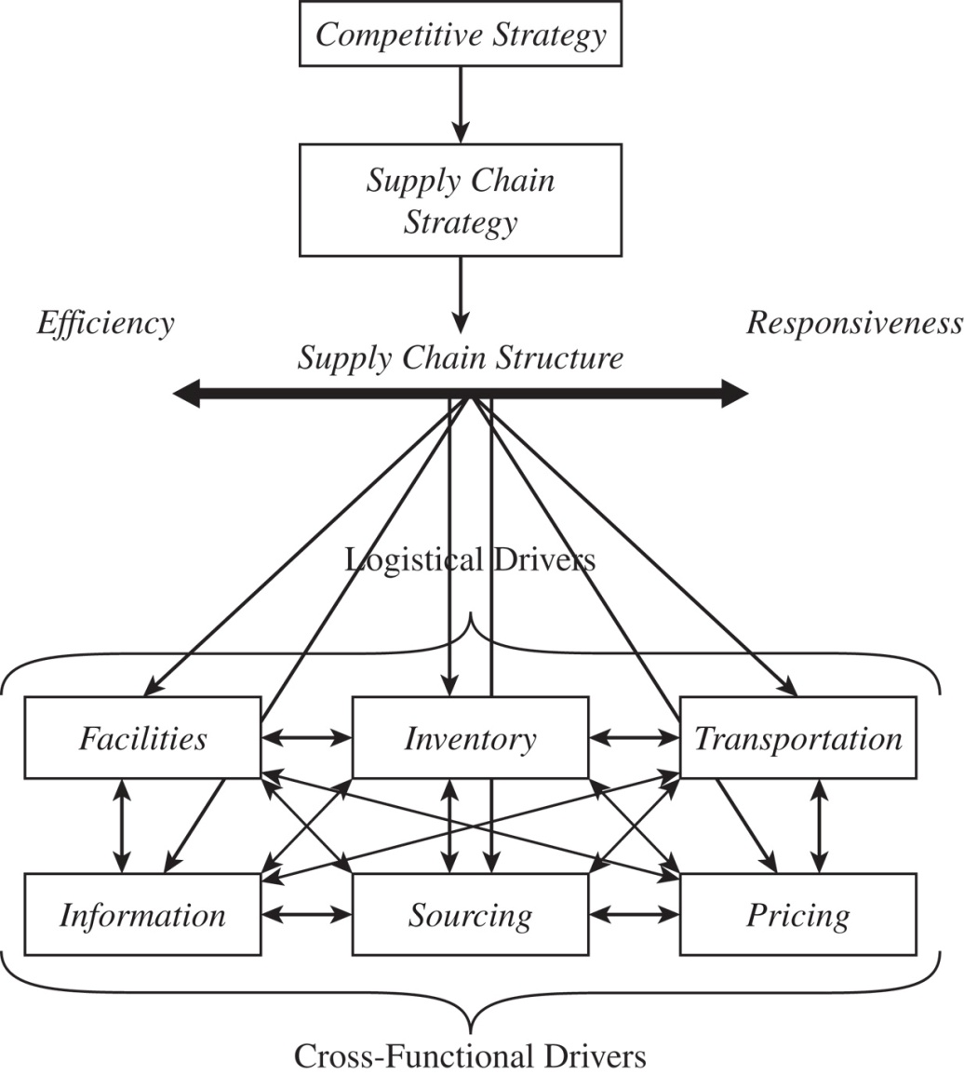
A Framework for Structuring Drivers
Figure 3-1

Slide 18
A Framework for Structuring Drivers
The goal of a supply chain strategy is to strike the balance between responsiveness and efficiency that fits with the competitive strategy and to reach this goal, right combination of discussed driver must be used.
Companies begin with a competitive strategy and then decide what their supply chain strategy ought to be.

Slide 19
A Framework for Structuring Drivers
Consider frame work for Wal-Mart as example.
Competitive strategy :To be a reliable, low-cost retailer for a wide variety of mass-consumption goods.
The ideal supply chain will emphasize efficiency but also maintain an adequate level of responsiveness.
Wal-Mart maintains an efficient supply chain by keeping low levels of inventory.
Cross-docking

Slide 20
A Framework for Structuring Drivers
For transportation, Wal-Mart runs its own fleet, keeps responsiveness high. This increases transportation cost, but the benefits in terms of reduced inventory and improved product availability justify this cost.
For facilities, Wal-Mart uses centrally located DCs within its network of stores to decrease the number of facilities and increase efficiency at each DC.Stores are only there where demand is sufficient enough.

Slide 21
A Framework for Structuring Drivers
For information technology usage,Wal-Mart is the leader. It feeds demand information across the supply chain to suppliers who manufacture only what is being demanded.
For sources, Wal-Mart feeds them large orders, making them to be efficient by exploiting economies of scale.
For pricing, Wal-Mart practices "every day low pricing“.

Slide 22
Facilities
ROLE IN THE SUPPLY CHAIN
Referred as “Where” of supply chain
The locations to or from which the inventory is transported
Inventory is either transformed into another state or it is stored.

Slide 23
Facilities
ROLE IN THE COMPETITIVE STRATEGY
Companies can gain economies of scale when a product is manufactured or stored in only one location. Efficiency is priority.
Opposite is also true. Larger number of facilities. Responsiveness is priority.
Example: Toyota and Honda use facilities decisions to be more responsive.
Other benefits: Protection from currency fluctuation and trade barriers.

Slide 24
Components Of Facilities Decisions
Role
Flexible, dedicated, or a combination of the two
Product focus(fabrication and assembly) or a functional focus(only fabrication or only assembly)
Warehouses: Cross-docking or storage.

Slide 25
Components Of Facilities Decisions
Location
Where a company will locate its facilities
Centralize or decentralize
Macroeconomic factors, quality of workers, cost of workers, cost of facility, availability of infrastructure, proximity to customers, the location of that firm's other facilities.

Slide 26
Components Of Facilities Decisions
Capacity
Shows a facility's capacity to perform its intended functions
Excess capacity-more responsive but costly
Little excess capacity-efficient but less responsive

Slide 27
Components Of Facilities Decisions
Facility related metrics
Capacity-measures the maximum amount a facility can process.
Utilization -measures the fraction of capacity that is currently being used in the facility.
Theoretical cycle time of production- measures the time required to process a unit if there are absolutely no delays at any stage

Slide 28
Facility related metrics
Actual cycle time- measures the average actual time taken for all units processed over a specified duration such as a week or month
Flow time efficiency- the ratio of the theoretical flow time to the actual average flow time
Product variety- measures the number of products/product families processed in a facility

Slide 29
Facility related metrics
Processing/Setup/Down/Idle time- measure the fraction of time that the facility was processing units, being set up to process units, unavailable because it was down, or idle because it had no units to process
Average production batch size- measures the average amount produced in each production batch
Production service level- measures the fraction of production orders completed on time and in full.

Slide 30
Overall trade-off: Responsiveness versus efficiency
Fundamental trade-off between cost of the number, location, type of facilities and level of responsiveness
number of facilities - facility and
inventory cost
transportation
cost and response time

Slide 31
Inventory
ROLE IN THE SUPPLY CHAIN
Why it exists- mismatch between supply and demand
Intentional at a steel manufacturer and retail stores
Exploiting economies of scale
Affects cost

Slide 32
Inventory
Affects responsiveness :
More inventory more responsiveness
Less inventory more efficient
Material flow time: The time that elapses between the point at which material enters the supply chain to the point at which it exits
Throughput is the rate at which sales occurs.
Little's law: l=DT
I=Inventory, T=Flow time, D=Throughput

Slide 33
Inventory
ROLE IN THE COMPETITIVE STRATEGY
Location and quantity makes a supply chain of low cost or responsive
Decision is taken to get right quantity and location for the inventory at lowest cost.

Slide 34
Inventory
Example: Nordstrom's competitive strategy targets upper-end customers with high responsiveness requirements. Nordstrom uses inventory; the company stocks a large variety and quantity of products to ensure a high level of availability. Customers are ready to pay.

Slide 35
Inventory
COMPONENTS OF INVENTORY DECISIONS
Cycle inventory: The average amount of inventory used to satisfy demand between receipts of supplier shipments
Size of the cycle inventory is a result of the production, transportation, or purchase of material in large lots. With the increase in lot size, however, also comes an increase in carrying costs.
Example: The book retailer selling 10 truckloads a month could order 10 truckloads once each month or it could order one truckload every three days.

Slide 36
COMPONENTS OF INVENTORY DECISIONS
Safety inventory: It is held to counter uncertainty because demand is uncertain and may exceed expectations.
Example: A toy retailer must calculate its safety inventory for the holiday buying season.
If it has too much safety inventory, toys go unsold . If the company has too little safety inventory, however, then Toy loses sales, along with the margin.

Slide 37
COMPONENTS OF INVENTORY DECISIONS
Seasonal Inventory: Built up to counter predictable variability in demand
Companies build up inventory in periods of low demand and store it for periods of high demand when they will not have the capacity to produce all that is demanded.
Therefore, the basic trade-off is between the cost of carrying the additional seasonal inventory versus the cost of having a more flexible production rate.

Slide 38
COMPONENTS OF INVENTORY DECISIONS
Level of Product Availability: The fraction of demand that is served on time from product held in inventory
The basic trade-off is between the cost of inventory to increase product availability and the loss from not serving customers on time.

Slide 39
COMPONENTS OF INVENTORY DECISIONS
Inventory-Related Metrics
Average inventory- measures the average amount of inventory carried
Products with more than a specified number of days of inventory- identifies the products for which the firm is carrying a high level of inventory

Slide 40
Inventory-Related Metrics
Average replenishment batch size- measures the average amount in each replenishment order
Average safety inventory- measures the average amount of inventory on hand when a replenishment order arrives

Slide 41
Inventory-Related Metrics
Seasonal inventory- measures the amount of both cycle and safety inventory that is purchased solely due to seasonal changes in demand
Fill rate- measures the fraction of orders/demand that were met on time from inventory.
Fraction of time out of stock- measures the fraction of time that a particular SKU(stock keeping units) had zero inventory

Slide 42
Inventory
Overall Trade-Off: Responsiveness Versus Efficiency
Increasing inventory generally makes the supply chain more responsive.
A higher level of inventory also facilitates a reduction in production and transportation costs but also increases inventory holding cost.

Slide 43
Transportation
ROLE IN THE SUPPLY CHAIN
Moves product between different stages
Affects responsiveness and efficiency
Faster transportation -more responsive but less efficient

Slide 44
Transportation
Example: Dell flies some components from Asia because doing so allows the company to lower the level of inventory it holds. This increases responsiveness but reduces efficiency

Slide 45
Transportation
ROLE IN THE COMPETITIVE STRATEGY
Company can use transportation for the customers who want more responsiveness and also for those who want less price.
The optimal decision for the company often means finding the right balance between the two.

Slide 46
Transportation
Example: Laura Ashley sells clothing and other household items through a mail-order catalogue and uses transportation as a part of competitive strategy.
To meet high level of responsiveness, the company has located its main warehouse near the FedEx hub.

Slide 47
Transportation
COMPONENTS OF TRANSPORTATION DECISIONS
Design of Transportation Network
Collection of transportation modes, locations, and routes along which product can be shipped
Transportation may be direct or may go through intermediate consolidation points
Single/Multiple supply or demand points

Slide 48
COMPONENTS OF TRANSPORTATION DECISIONS
Choice of Transportation Mode
Manner in which a product is moved from one location to another
Modes : Air, truck, rail, sea, and pipeline
Information goods through internet
Each mode has different characteristics with respect to the speed, size of shipments, cost of shipping, and flexibility

Slide 49
COMPONENTS OF TRANSPORTATION DECISIONS
Transportation-Related Metrics
Average inbound transportation cost: measures the cost of bringing product into a facility as a percentage of sales or cost of goods sold (COGS).
Average incoming shipment size :measures the average number of units or dollars in each incoming shipment
Average inbound transportation cost per shipment :measures the average transportation cost of each incoming delivery.

Slide 50
Transportation-Related Metrics
Average outbound transportation cost: measures the cost of sending product out of a facility to the customer.
Average outbound shipment size measures the average number of units or dollars on each outbound shipment
Average outbound transportation cost per shipment: measures the average transportation cost of each outgoing delivery
Fraction transported by mode: measures the fraction of transportation using each mode of transportation

Slide 51
Transportation
Overall Trade-Off: Responsiveness Versus Efficiency
Trade-off for transportation is between the cost of transporting a given product (efficiency) and the speed with which that product is transported (responsiveness)
Fast modes of transport raises responsiveness and transportation cost but lowers the inventory holding cost

Slide 52
Information
ROLE IN THE SUPPLY CHAIN
Serves as the connection between various stages of a supply chain
Crucial to the daily operations of each stage in a supply chain
Example: A production scheduling system uses information on demand to create a schedule that allows a factory to produce the right products in an efficient manner

Slide 53
Information
ROLE IN THE COMPETITIVE STRATEGY
Right information can help a supply chain better meet customer needs at lower cost
Key decision involves what information is most valuable in reducing cost and improving responsiveness
Some companies target customers who require customized products that carry a premium price tag

Slide 54
Information
Example: Andersen Windows, a major manufacturer of residential wood windows has invested in an information system that enables the company to bring customized products to the market rapidly.
"Window of Knowledge” system
User can select from a library of over 50,000 components that can be combined in any number of ways. The system immediately gives the customer price quotes and automatically sends the order to the factory if the customer decides to buy.

Slide 55
Information
Example: Dell takes orders directly from consumers over the phone and via the Internet.
With the direct channel model Dell is able to view the actual consumer demand much sooner than most PC manufacturers
The company can respond more quickly to changes in consumer needs at lower cost

Slide 56
Information
COMPONENTS OF INFORMATION DECISIONS
Push Versus Pull
Push systems generally require information in the form of elaborate material requirements planning (MRP) systems
Pull systems require information on actual demand to be transmitted extremely quickly throughout the entire chain so that production and distribution of products may reflect the real demand accurately

Slide 57
COMPONENTS OF INFORMATION DECISIONS
Coordination and Information Sharing
All stages of a supply chain work toward the objective of maximizing total supply chain profitability
Coordination among different stages in a supply chain requires each stage to share appropriate information with other stages

Slide 58
COMPONENTS OF INFORMATION DECISIONS
Forecasting and Aggregate Planning
Obtaining forecasting information frequently means using sophisticated techniques to estimate future sales
Companies often use forecasts both on a tactical level to schedule production and on a strategic level to determine whether to build new plants
Aggregate planning transforms forecasts into plans of activity to satisfy the projected demand

Slide 59
COMPONENTS OF INFORMATION DECISIONS
Enabling Technologies
Electronic data interchange (EDI): Allows companies to place instantaneous, paperless purchase orders with suppliers. It decreases the time needed.
Internet: It conveys much more information. Internet communication among stages in the supply chain is also easier because a standard infrastructure already exists.
Cont...

Slide 60
COMPONENTS OF INFORMATION DECISIONS
Enterprise resource planning (ERP) systems It provides the transactional tracking and global visibility of information. The real-time information helps a supply chain to improve the quality of its operational decisions
Supply chain management (SCM) software: It uses the information in ERP systems to provide analytical decision support.
Cont...

Slide 61
COMPONENTS OF INFORMATION DECISIONS
Radio frequency identification (RFID): It consists of an active or passive radio frequency (RF) tag applied to the item being tracked and an RF reader/emitter. Wal-Mart has mandated the use of RFID technology by its top 100 suppliers at the case level. The technology can make the receiving of a truck much faster and cheaper

Slide 62
COMPONENTS OF INFORMATION DECISIONS
Information-Related Metrics
Forecast horizon: It identifies how far in advance of the actual event a forecast is made
Frequency of update: It identifies how frequently each forecast is updated
Forecast error : It measures the difference between the forecast and actual demand
Cont...

Slide 63
COMPONENTS OF INFORMATION DECISIONS
Seasonal factors: It measure the extent to which the average demand in a season is above or below the average in the year
Variance from plan: It identifies the difference between the planned production/inventories and the actual values
Ratio of demand variability to order variability: It measures the standard deviation of incoming demand and supply orders placed

Slide 64
Information
Overall Trade-Off: Responsiveness Versus Efficiency
The information driver is used to improve the performance of other drivers. Accurate information can help a firm improve efficiency by decreasing inventory and transportation costs.
More information is not always better
Evaluate the minimum information required to accomplish the desired objectives

Slide 65
Sourcing
ROLE IN THE SUPPLY CHAIN
The set of business processes required to purchase goods and services.
For each outsourced task, the manager must decide whether to source from a single supplier or a portfolio of suppliers
Cont...

Slide 66
Sourcing
Suppliers are selected and their performances are measured.
Once suppliers and contracts are in place, procurement processes that facilitate the placement and delivery of orders play a major role
Globalization creates many more sourcing options with both considerable opportunity and potential risk

Slide 67
Sourcing
ROLE IN THE COMPETITIVE STRATEGY
Firms outsource to responsive third parties if it is too expensive for them to develop this responsiveness on their own
Firms have kept the responsive process in-house, to maintain control. Benetton keeps the dyeing of knit garments in-house so it can respond quickly to orders as they arrive.

Slide 68
ROLE IN THE COMPETITIVE STRATEGY
Example: Cisco has outsourced almost all of its manufacturing. For low-end products such as routers for home networks, Cisco aims for efficiency. Cisco aims for the lowest-cost manufacturing location and economies of scale in transportation because the targeted market segment values low cost.
For high-end products, in contrast, Cisco outsources to contract manufacturers in the United States.

Slide 69
Sourcing
COMPONENTS OF SOURCING DECISIONS
In-House or Outsource
Perform a task in-house or outsource it to a third party
This decision should be driven in part by its impact on the total supply chain profit

Slide 70
COMPONENTS OF SOURCING DECISIONS
Supplier Selection
The number of suppliers for a particular activity
Identification of criteria ,direct negotiation or auction

Slide 71
COMPONENTS OF SOURCING DECISIONS
Procurement
The supplier sends product in response to customer orders
Managers must decide on the structure of procurement of direct as well as indirect materials, and strategic as well as general material

Slide 72
COMPONENTS OF SOURCING DECISIONS
Sourcing-Related Metrics
Days payable outstanding measures the number of days between when a supplier performed a supply chain task and when it was paid
Average purchase price measures the average price at which a good or service was purchased during the year
Range of purchase price measures the fluctuation in purchase price during a specified period
Cont...

Slide 73
COMPONENTS OF SOURCING DECISIONS
Average purchase quantity measures the average amount purchased per order
Fraction on-time deliveries measures the fraction of deliveries from the supplier that were on time
Supply quality measures the quality of product supplied
Supply lead time measures the average time between when an order is placed and the product arrives.

Slide 74
Sourcing
Overall Trade-Off: Increase the Supply Chain Profits
Sourcing decisions should be made to increase the size of the total profit to be shared across the supply chain.
The total profits are affected by the impact of sourcing on sales, service, production costs, inventory costs, transportation costs, and information costs.
Outsourcing to a third party is meaningful if the third party raises the supply chain profits more than the firm can by its own.

Slide 75
Pricing
ROLE IN THE SUPPLY CHAIN
The process by which a firm decides how much to charge customers for its goods and services
It affects the customer segments that choose to buy the product, as well as the customer's expectations
A lever that can be used to match supply and demand

Slide 76
Pricing
ROLE IN THE COMPETITIVE STRATEGY
Customers expect low prices but are comfortable with a lower level of product availability
Costco, a membership-based wholesaler in the United States, has a policy that prices are kept steady but low
Some manufacturing and transportation firms use pricing that varies with the response time desired by the customer

Slide 77
Pricing
Example: Amazon offers its customers a large menu of prices for products that are purchased from the company
A person purchasing two books worth $30 could use standard shipping (ships in 3-5 business days) at a cost of $4.98, two-day shipping (ships in 2 business days) at a cost of $11.47, one-day shipping (ships in 1 business day) at a cost of $20.47 or use free shipping (ships in 7-14 business days)

Slide 78
Pricing
COMPONENTS OF PRICING DECISIONS
Pricing and Economies of Scale
Changeovers make small production runs more expensive per unit than large production runs
The provider of the supply chain activity must decide how to price it appropriately to reflect these economies of scale
A commonly used approach is to offer quantity discounts
Cont...

Slide 79
Pricing
Everyday Low Pricing Versus High-Low Pricing
Everyday low pricing is applied with stable demand
The high-low pricing strategy results in a peak during the discount week, often followed by a steep drop in demand during the following weeks
Cont...

Slide 80
Fixed Price Versus Menu Pricing
Fixed price for its supply chain activities or a menu with prices that vary with some other attribute
If marginal supply chain costs or the value to the customer vary significantly along some attribute, it is often effective to have a pricing menu
The pick, pack, and deliver cost at the warehouse, however, is higher in the case of a personal pickup compared to home delivery.
The pricing policy thus can lead to customer behaviour that has a negative impact on profits
Cont...

Slide 81
Pricing
Pricing-Related Metrics
Profit margin measures profit as a percentage of revenue
Days sales outstanding measures the average time between when a sale is made and when the cash is collected
Cont...

Slide 82
Pricing-Related Metrics
Incremental fixed cost per order measures the incremental costs that are independent of the size of the order
Incremental variable cost per unit measures the incremental costs that vary with the size of the order
Cont...

Slide 83
Pricing-Related Metrics
Average sale price measures the average price at which a supply chain activity was performed in a given period
Average order size measures the average quantity per order
Cont...

Slide 84
Pricing-Related Metrics
Range of sale price measures the maximum and the minimum of sale price per unit over a specified time horizon
Range of periodic sales measures the maximum and minimum of the quantity sold per period during a specified time horizon

Slide 85
Pricing
Overall Trade-Off: Increase Firm Profits
Requires an understanding of the cost structure of performing a supply chain activity and the value this activity brings to the supply chain
Pricing strategies may lower supply chain costs, defend market share, or even steal market share
Differential pricing may be used to attract customers with varying needs

Slide 86
OBSTACLES TO ACHIEVING STRATEGIC FIT
INCREASING VARIETY OF PRODUCTS
The increase in product variety complicates the supply chain by making forecasting much more difficult
Increased variety tends to raise uncertainty
The number of running shoe styles sold in the United States went from five in the early 1970s to almost 300 by the late 1990s

Slide 87
OBSTACLES TO ACHIEVING STRATEGIC FIT
DECREASING PRODUCT LIFE CYCLES
There are products whose life cycles can be measured in months, compared to the old standard of years
PCs now have a life cycle of several months, and even some automobile manufacturers have lowered their product life cycles from five plus years to about three years
Shorter life cycles increase uncertainty while reducing the window of opportunity

Slide 88
OBSTACLES TO ACHIEVING STRATEGIC FIT
INCREASINGLY DEMANDING CUSTOMERS
Demanding improvements in delivery lead times, cost, and product performance
Today's customers are demanding faster fulfilment, better quality, and better-performing products for the same price they paid years ago.
This tremendous growth in customer demands (not necessarily demand) means that the supply chain must provide more just to maintain its business

Slide 89
OBSTACLES TO ACHIEVING STRATEGIC FIT
FRAGMENTATION OF SUPPLY CHAIN OWNERSHIP
Most firms have become less vertically integrated
With the chain broken into many owners, each with its own policies and interests, the chain is more difficult to coordinate

Slide 90
OBSTACLES TO ACHIEVING STRATEGIC FIT
GLOBALIZATION
Establishing a global supply chain creates many benefits, such as the ability to source from a global base of suppliers
It also adds stress to the chain, because facilities within the chain are farther apart, making coordination much more difficult
Globalization has also increased competition
This competitive situation makes supply chain performance a key to maintaining and growing sales

Slide 91
OBSTACLES TO ACHIEVING STRATEGIC FIT
DIFFICULTY EXECUTING NEW STRATEGIES
The execution of the strategy can be difficult
Toyota's production system, which is a supply chain strategy, has been widely known and understood
The skilful execution of a strategy can be as important as the strategy itself.

Slide 92
OBSTACLES TO ACHIEVING STRATEGIC FIT
SIMULTANEOUS PURSUIT OF RESPONSIVENESS AND EFFICIENCY
Between supply chains that are equally responsive, the more efficient is likely to be more successful
Providing a higher responsiveness at a given cost and the same level of responsiveness at a lower cost are both desirable to gaining competitive advantage
The concept of mass customization adopted by Asian Paints has reduced inventories in the distribution system and yet enhanced responsiveness by offering range of colours

Slide 93
Summary of Learning Objectives
Identify the major drivers of supply chain performance
Discuss the role of each driver in creating strategic fit between the supply chain strategy and the competitive strategy
Define the key metrics that track the performance of the supply chain in terms of each driver
Describe key financial measures of firm performance

